Slide 1

CSC 215-01 Artificial Intelligence Final Project (Type A) : Sentiment analysis of product review data
Meghana Rao Kanneganti, 302804645
Nikitha Mandhana, 303315350
California State University, Sacramento
Department of Computer Science
1st May 2023

Slide 2
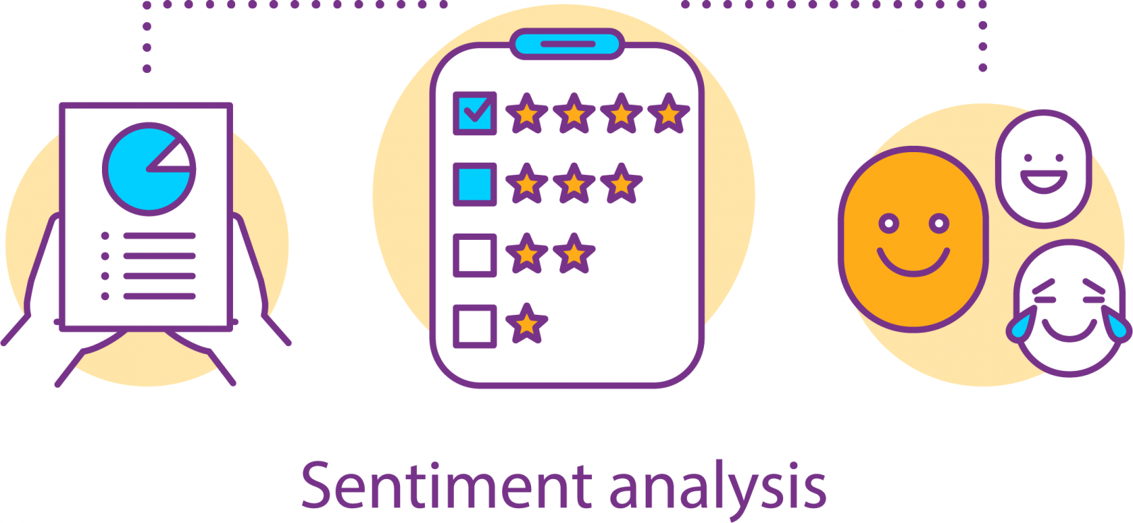
Objective
Sentiment analysis of product review data is the process of using natural language processing and machine learning techniques to extract subjective information from product reviews posted by customers on e-commerce platforms and social media sites.
The objective of sentiment analysis is to identify the sentiment of a product review as positive or negative. This information can help companies understand the opinions and preferences of their customers, improve their products and services, and make data-driven decisions.
Sentiment analysis of product review data is particularly important for e-commerce companies that rely heavily on customer reviews to drive sales, as positive reviews can influence customer behavior and increase revenue.

Slide 3
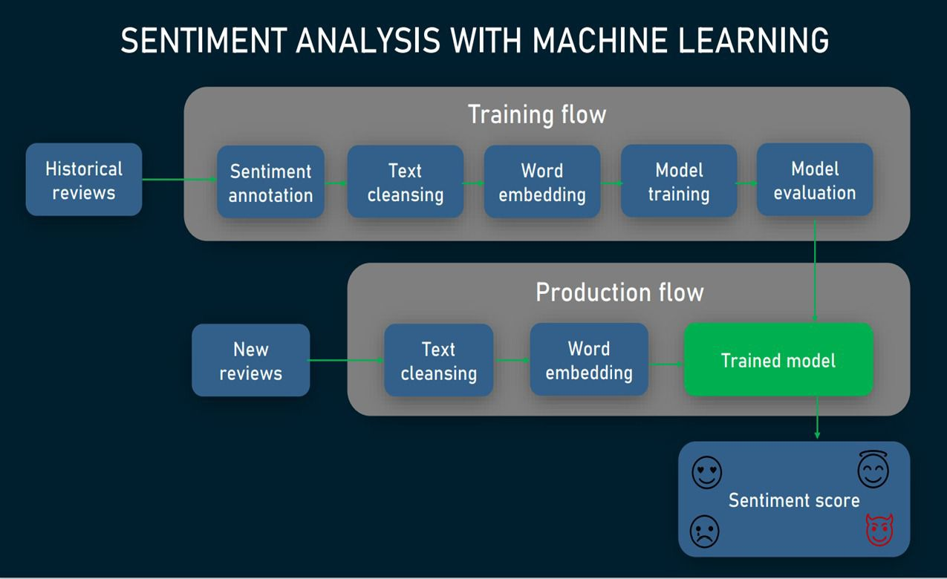
Sentimental Analysis with Machine Learning
Notes:
The image depicts a typical workflow for building a sentiment analysis model using machine learning techniques. The workflow starts with collecting the data, which could be done by scraping data from social media or e-commerce websites, or by using pre-existing datasets.
Next, the data is preprocessed by cleaning and normalizing it, such as removing stop words, stemming or lemmatization, and tokenization.
After preprocessing, the data is split into training and testing sets, with the training set being used to train the model and the testing set used to evaluate its performance.
Several machine learning models can be used for sentiment analysis, including Naive Bayes, Support Vector Machines (SVM), Decision Trees, and Neural Networks. The models are trained on the training data and tuned to improve their performance using techniques like hyperparameter tuning and cross-validation.
Finally, the trained model is deployed in production and integrated into the application, where it can be used to classify the sentiment of new data, such as product reviews or social media posts. The output can be positive, negative or neutral, which can then be used to derive insights for decision-making purposes.

Slide 4
Introduction
The paper (Sentimental Analysis) titled "Co-LSTM: Convolutional LSTM model for sentiment analysis in social big data" proposes a new approach for sentiment analysis in social big data.
The motivation behind the problem is the increasing amount of user-generated content in social media and the need for automated techniques to analyze sentiments expressed in such data.
The problem statement is to develop an effective model for sentiment analysis in social big data using Convolutional LSTM architecture.
To solve the problem, the authors proposed a novel model called Co-LSTM, which is a Convolutional LSTM architecture that incorporates convolutional and pooling layers with LSTM.
The model utilizes the advantages of both convolutional and LSTM layers for feature extraction and context modeling, respectively, to capture the complex relationships between words in social big data.
The proposed Co-LSTM model was compared with several state-of-the-art models on benchmark datasets for sentiment analysis, and the results demonstrated the superior performance of the Co-LSTM model over the baseline approaches.
We proposed a solution where in we use GPT with RNN model in order to beat the results obtained in the research paper.

Slide 5
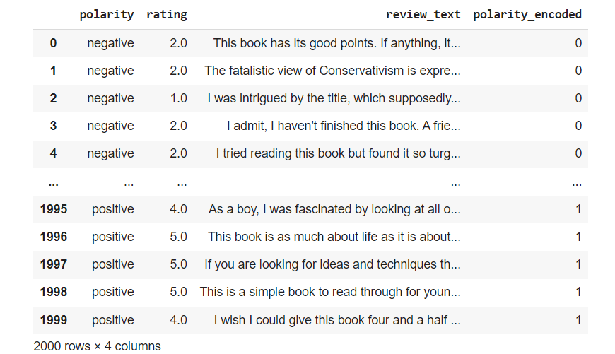
About the dataset
The dataset provided by Multi-Domain Sentiment Dataset (jhu.edu) consists of user reviews collected from multiple websites such as Amazon.
It contains reviews of various types of products such as books, movies, and electronics, and includes both positive and negative reviews.
The dataset is labeled with binary sentiment labels (positive or negative), and it is intended for use in sentiment analysis tasks.
The dataset is consisting of multiple directories. Each directory corresponds to a single domain. Each directory contains several files, which we briefly describe: all.review -- All reviews for this domain, in their original format positive.review -- Positive reviews negative.review -- Negative reviews unlabeled.review -- Unlabeled reviews processed.review -- Preprocessed reviews processed.review.balanced -- Preprocessed reviews, equally balanced between positive and negative
Each file contains a pseudo-XML scheme for encoding the reviews.

Slide 6
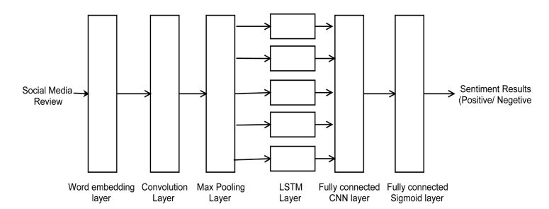
Implementation of Co-LSTM Model
1. Preprocessing: The input text data is preprocessed by tokenizing the text and converting it into a sequence of integers using a pre-trained word embedding model. The sequences are padded or truncated to a fixed length.
2. Convolutional layer: The first layer in the Co-LSTM model is a 1D convolutional layer with multiple filters. The convolutional layer extracts the features from the input sequences by applying a sliding window of size k to each sequence.
3. Pooling layer: The output of the convolutional layer is passed through a max pooling layer, which down samples the feature maps to reduce the dimensionality of the input.

Slide 7
Implementation of Co-LSTM Model
4. LSTM layer: The pooled output from the convolutional and pooling layers is then passed through an LSTM layer. The LSTM layer captures the temporal dependencies between the words in the input sequence and generates a fixed-length output vector.
5. Dense layer: The output from the LSTM layer is passed through a dense layer with a SoftMax activation function, which generates a probability distribution over the target sentiment classes.
6. Training: The Co-LSTM model is trained using backpropagation and stochastic gradient descent with the cross-entropy loss function. The model is trained on a labeled dataset of social big data, such as Amazon dataset.
7. Evaluation: The performance of the Co-LSTM model is evaluated on a separate test dataset using various evaluation metrics such as accuracy, precision, recall, and F1-score. The results are compared with the baseline models to measure the effectiveness of the Co-LSTM model.

Slide 8
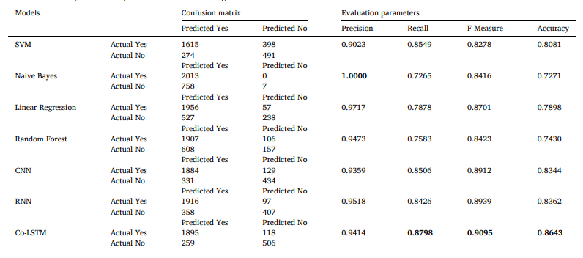
Comparative Analysis of the Classification Models in Base Paper

Slide 9
Improvement Model - Co-LSTM with Bert Embedding
Here, we have trained the sentiment analysis model using the BERT model in TensorFlow.
The dataset is read from two XML files, positive and negative, each containing a set of reviews, and they are merged into one data frame.
Then, the data is split into training, validation, and test sets.
The text data is preprocessed using a BERT tokenizer and then passed to the BERT model, followed by a Conv1D layer, two LSTM layers, and two Dense layers with dropout.
Early stopping and model checkpoint are used as callbacks to improve the performance of the model.
The best model is saved and evaluated on the test set using the classification report function from sklearn.metrics, which calculates several evaluation metrics, such as precision, recall, F1 score, and accuracy. Finally, the accuracy score of the model is printed.

Slide 10
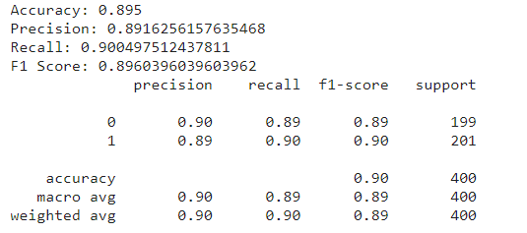
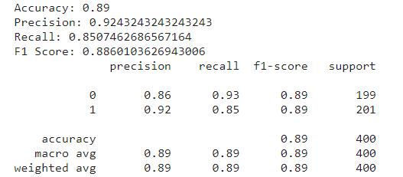
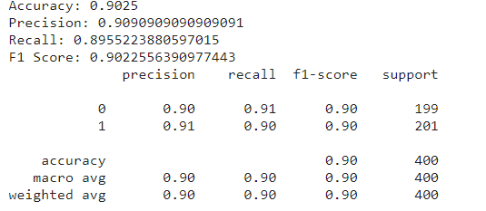
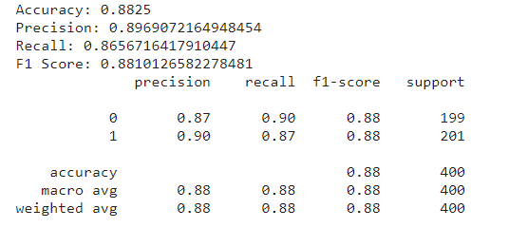
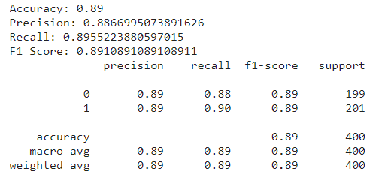
Results of Co-LSTM Model with Bert
Optimizer used: Sgd
Activation Function used : Relu
Optimizer used: Adam
Activation Function used : Sigmoid
Optimizer used: Sgd
Activation Function used : Sigmoid
Optimizer used: Adam
Activation Function used : Tanh
Optimizer used: Sgd
Activation Function used : Tanh

Slide 11
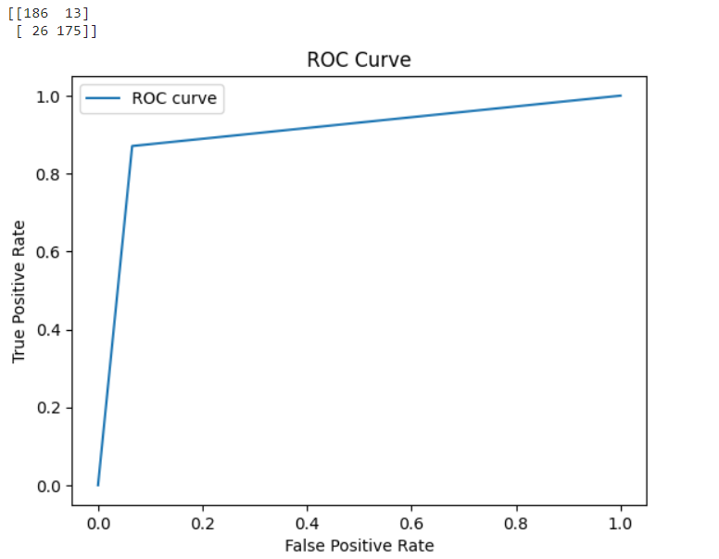
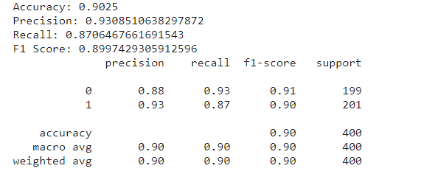
Results of Co-LSTM Model with Bert
Optimizer used: Adam
Activation Function used : Relu

Slide 12
Proposed Models
A CNN model with BERT embedding refers to a convolutional neural network (CNN) architecture that uses pre-trained BERT (Bidirectional Encoder Representations from Transformers) embeddings as input. In a CNN model with BERT embedding, the pre-trained BERT embeddings are used as input to the convolutional layers of the network. The convolutional layers are then used to extract features from the embeddings, and the output of these layers is passed to a fully connected layer for classification.
An RNN (Recurrent Neural Network) model with GPT (Generative Pre-trained Transformer) refers to a type of neural network architecture that uses GPT as a pre-trained language model to generate text data. In this architecture, the GPT model is combined with an RNN, which is a type of neural network that is particularly good at modeling sequential data, such as time series or natural language.
The RNN component of the model is typically used to capture dependencies between different words or phrases in the input text. It works by maintaining a "memory" of previous inputs and using this memory to inform predictions about future inputs. When combined with the GPT model, which has been pre-trained on a large corpus of text data, the resulting RNN model can generate text that is both coherent and stylistically consistent with the training data.
CNN Model with Bert Embedding
RNN Model with GPT

Slide 13
Model 1 : Bert with CNN
In this model we have fine-tuned a pre-trained BERT model for sentiment analysis on a dataset of positive and negative reviews.
The dataset is first read into a pandas Data Frame from XML files, and the text data is preprocessed by converting it to lowercase, removing non-alphabetic characters, tokenizing using the BERT tokenizer, and padding to a maximum length of 128.
The pre-trained BERT model is loaded from the Hugging Face transformers library, and a neural network is built on top of it for classification.
The architecture consists of a BERT layer, followed by three parallel 1D convolutional layers with different kernel sizes, and the output of each convolutional layer is concatenated and passed through a global max pooling layer.
A dropout layer is added to prevent overfitting, and the final output is a single sigmoid neuron for binary classification.
The code then loops through different combinations of hyperparameters (optimizers and activation functions) and trains the model using each set of hyperparameters.
The best model is selected based on the highest validation accuracy, and its performance is evaluated on the test set using accuracy, precision, recall, and F1 score.

Slide 14
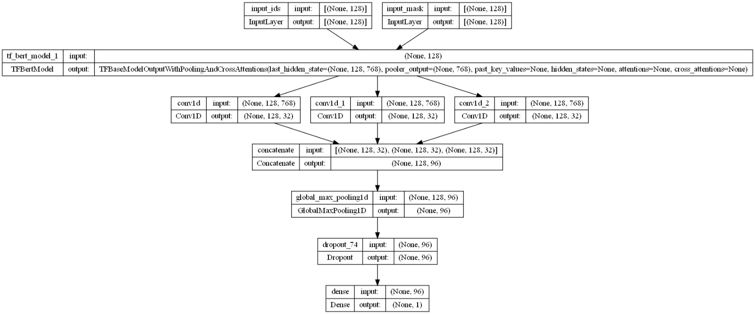
Model 1 : Bert with CNN

Slide 15
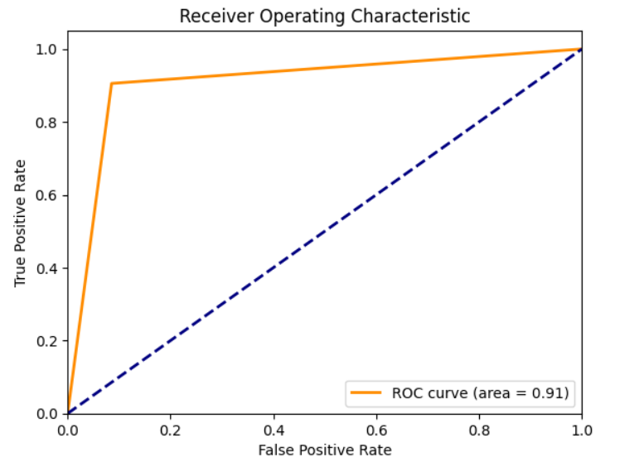
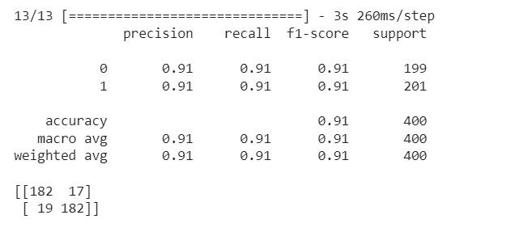
Results of CNN Model with Bert
We achieved the best results when we used Adam Optimizer and Relu Activation function. We were able to achieve an accuracy of 91%.
Optimizer used: Adam
Activation Function used : Relu

Slide 16
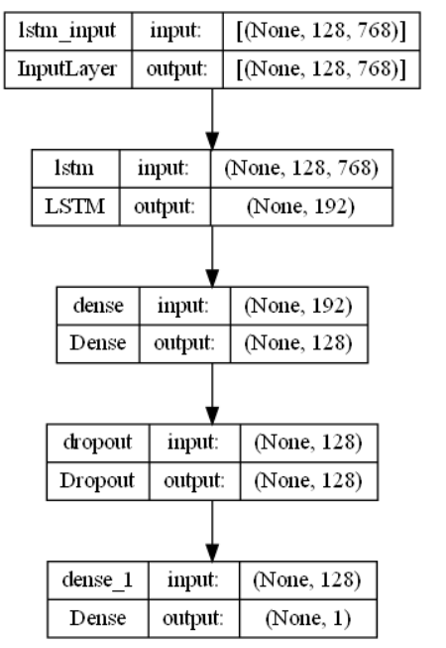
Model 2 : GPT with RNN
Here we read the dataset of reviews and their polarity (positive or negative) from XML files, preprocesses the review text, and then train a text classification model using a pre-trained GPT-2 language model.
Initially we import the required libraries and packages.
Read the reviews and their polarity from XML files and store them in a list of dictionaries.
Split the data into train and test sets.
Load a pre-trained GPT-2 model and tokenizer.
Tokenize the review texts using the tokenizer and encode the polarity labels using Label Encoder.
Pad the encoded sequences to a fixed length and convert the encoded labels to one-hot vectors.
Define a deep learning model using the Sequential API of Keras, consisting of an embedding layer, a convolutional layer, a pooling layer, an LSTM layer, and a dense output layer.
Train the model on the training set and monitor its performance on the validation set using checkpoints and early stopping.
Evaluate the model on the test set and report its accuracy, precision, recall, and F1-score.

Slide 17
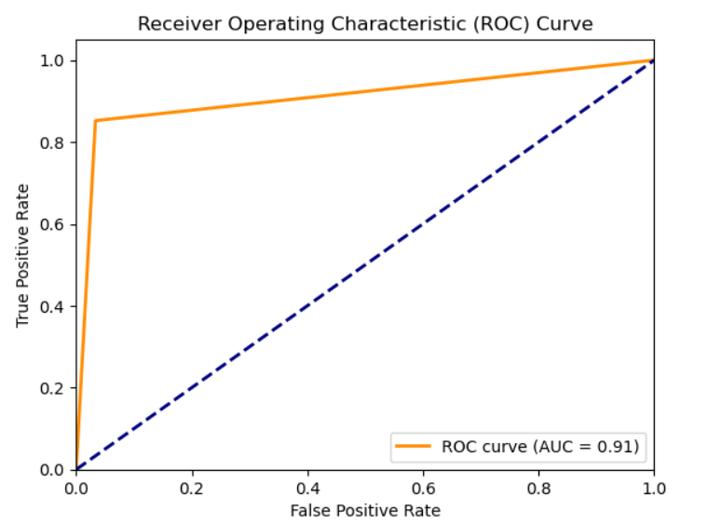
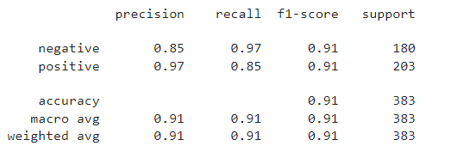
Results of RNN Model with GPT

Slide 18
Results comparison of all the Models
Precision | Recall | F1 Score | Accuracy
0.94 | 0.87 | 0.90 | 0.86
Validation Accuracy : 87%
CO-LSTM Model with Word2Vec Embedding (Base Paper)
Class | Precision | Recall | F1 Score | Support
Negative | 0.90 | 0.89 | 0.89 | 199
Positive | 0.89 | 0.90 | 0.90 | 201
Total | 0.90 | 0.90 | 0.90 | 400
Validation Accuracy : 90%
CO-LSTM Model with BERT (Improved solution)
Class | Precision | Recall | F1 Score | Support
Negative | 0.91 | 0.91 | 0.91 | 199
Positive | 0.91 | 0.91 | 0.91 | 201
Total | 0.91 | 0.91 | 0.91 | 400
Validation Accuracy : 90% CNN Model with BERT
Proposed Model 1
Class | Precision | Recall | F1 Score | Support
Negative | 0.85 | 0.97 | 0.91 | 180
Positive | 0.97 | 0.85 | 0.91 | 203
Total | 0.91 | 0.91 | 0.91 | 383
Validation Accuracy : 91%
RNN Model with GPT
Proposed Model 2

Slide 19
Conclusion
Upon comparing the proposed GPT-LSTM model to the Co-LSTM and Bert-CNN models, we observed that the GPT-LSTM model achieved the highest accuracy. We believe that using larger GPT and LSTM models could improve the performance of the proposed GPT-LSTM model on this sentiment analysis task. It is worth noting that due to limited computational resources, we used a small GPT model along with a simple LSTM model. While the Bert-CNN model achieved higher results, we also found that it is vulnerable to overfitting, which may affect its performance on new data.
The three models evaluated for sentiment analysis showed varying levels of performance. The GPT-LSTM model emerged as the top performer with an F1-score of 0.91, although it had lower precision for classifying the negative class. The Co-LSTM and BERT-CNN models achieved higher F1-scores of 0.89 and 0.91, respectively. Nevertheless, the GPT-LSTM model offers promise for sentiment analysis tasks as it combines the GPT language model and LSTM neural networks strengths.

Slide 20
Challenges Faced
Some of the challenges we faced while doing this project :
Understanding the theoretical foundations of the different NLP models and how to apply them to analyze textual data effectively.
Choosing the right model for a given task and understanding the strengths and weaknesses of each model.
Optimizing the performance of the models through hyperparameter tuning, which can be a time-consuming and challenging process.
Dealing with the complexity of the models and the large amounts of data required for training and testing them.

Slide 21
Learning experience and Work Division
Experience :
Working with NLP and sentiment analysis using GPT, BERT, CNN, and LSTM has been enlightening.
We started by learning about the theoretical foundations of these models and their practical applications in analyzing textual data, which provided a better understanding of how to optimize their performance.
One key insight we gained is the importance of selecting the right model for a given task. GPT and BERT are effective for language generation and understanding, while CNN and LSTM are better for text classification and sentiment analysis.
Another lesson learned is the value of hyperparameter tuning for achieving optimal performance.
Task Division :
As a team, we have divided the tasks of implementing the three models efficiently. We started working on the Bert-CNN and Co-LSTM individually and then worked on the proposed model together. After discussing the models thoroughly, we have implemented the hyper-parameter tuning for each of these models discussing the best suitable and available approaches for tuning.

Slide 22
References
[1] Behera, R. K., Jena, M., Rath, S. K., and Misra, S. (2021). Co-LSTM: Convolutional LSTM model for sentiment analysis in social big data. Information Processing & Management, 58(1), 102435. doi: 10.1016/j.ipm.2020.102435
[2] Wang, Y., Huang, M., Zhu, X., and Zhao, L. (2016). Attention-based LSTM for aspect-level sentiment classification. In Proceedings of the 2016 Conference on Empirical Methods in Natural Language Processing (pp. 606-615).
[3] Chen, L.-C., Barron, J. T., Papandreou, G., Murphy, K., and Yuille, A. L. (2016). Semantic image segmentation with task-specific edge detection using CNNs and a discriminatively trained domain transform. In Proceedings of the IEEE Conference on Computer Vision and Pattern Recognition (pp. 4545-4554)
[4] Kim, Y. (2014). Convolutional neural networks for sentence classification. In Proceedings of the 2014 Conference on Empirical Methods in Natural Language Processing (EMNLP) (pp. 1746-1751).
[5] Tang, D., Qin, B., and Liu, T. (2015). Sentiment analysis with global topics and local dependency. In Proceedings of the 53rd Annual Meeting of the Association for Computational Linguistics and the 7th International Joint Conference on Natural Language Processing (Volume 1: Long Papers) (pp. 426-435).
[6] Devlin, J., Chang, M. W., Lee, K., & Toutanova, K. (2019). BERT: Pre-training of deep bidirectional transformers for language understanding. In Proceedings of the 2019 Conference of the North American Chapter of the Association for Computational Linguistics: Human Language Technologies (NAACL-HLT) (pp. 4171-4186).

